Slide 1
The Tragedy of Julius Caesar (1599)
By William Shakespeare

Slide 2
The Real Julius Caesar
Lived from 102 BC to 44 BC in Rome
A great military leader
Became a member of the First Triumvirate (three-men governing body)
Believed himself to be a defender of the common person
Declared dictator for ten years, made his supporters senators

Slide 3
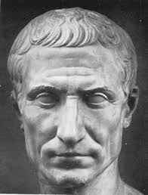
The Real Julius Caesar
The common people loved him and he was declared dictator for life.
He wanted to become king, but Rome had not had a king in 450 years since it was a republic.

Slide 4
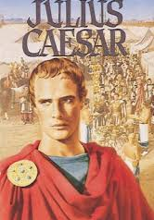
Shakespeare’s Caesar
Begins a month before the assassination in 44 BC
A five act play in which the third act is key
Written in unrhymed iambic pentameter which is called blank verse (see pg. 1192)
First performed on September 21, 1599

Slide 5
Conventions
Tragic Hero – a man of high status who has a tragic flaw that brings about his destruction, which he faces with dignity
Dramatic Irony – when the audience knows something the characters do not
Soliloquy – a long speech to reveal his inner thoughts delivered by a character who is alone on stage
Aside – a comment meant for the audience or a specific character, but not the other characters on stage

Slide 6
Themes
Chaos results when the prescribed social order is broken
The best intentions of good, noble men can lead to tragedy
Language is a powerful weapon, and in the hands of a skilled speaker, it can be used to manipulate others
Violence and bloodshed can never have morally good results
Orderliness and a stable rule, even though dictatorial, are preferable to social chaos

